Slide 1
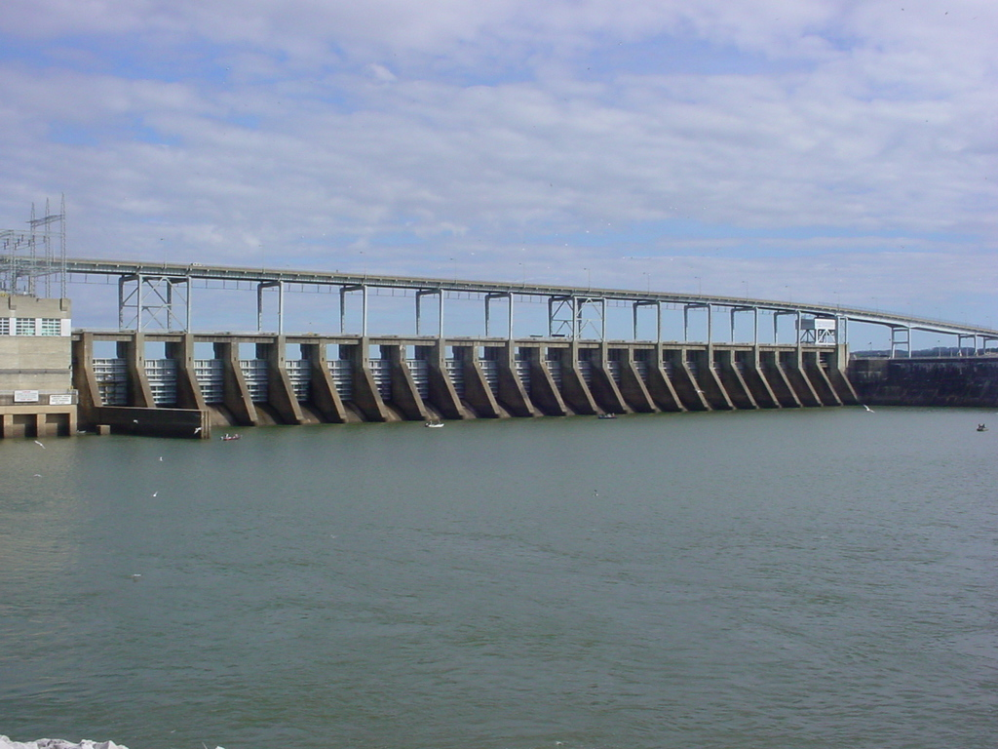
Fisheries Management Fish Habitat Information
Michael Clark
Reservoir Biologist

Slide 2
HISTORY OF FISH ATTRACTOR PROGRAM
The past couple of decades consisted of Agency personnel maintaining shallow water wooden stake beds and weighed tree tops in deeper water.
Shallow water attractors are marked with white PVC pipe and deep water attractors are marked with buoys. Each will be shown in later pictures.

Slide 3
MAINTENANCE
Kentucky Reservoir was divided into three sections for a rotational maintenance schedule.
TWRA would maintain deep water buoy placement year round and refresh sites every third year.

Slide 4
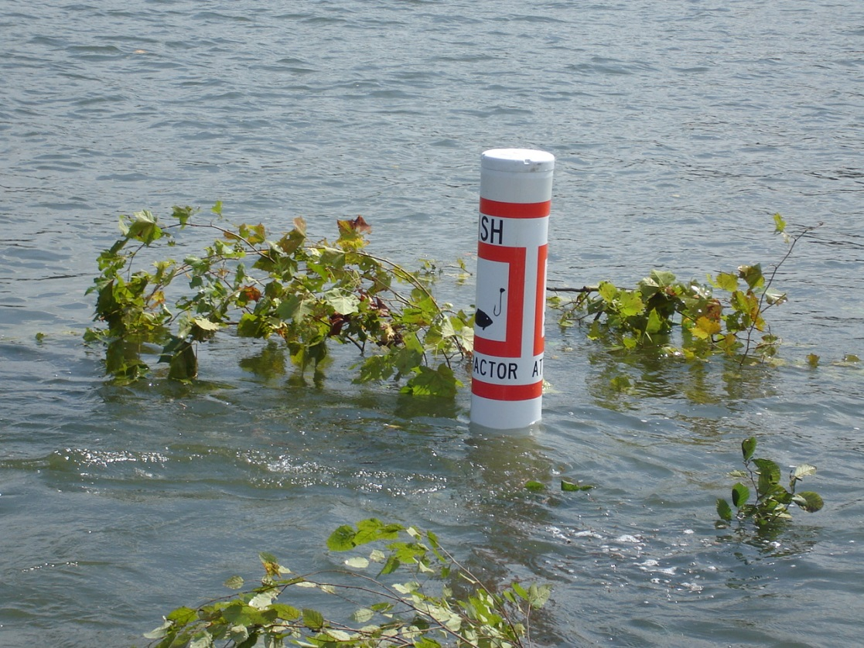
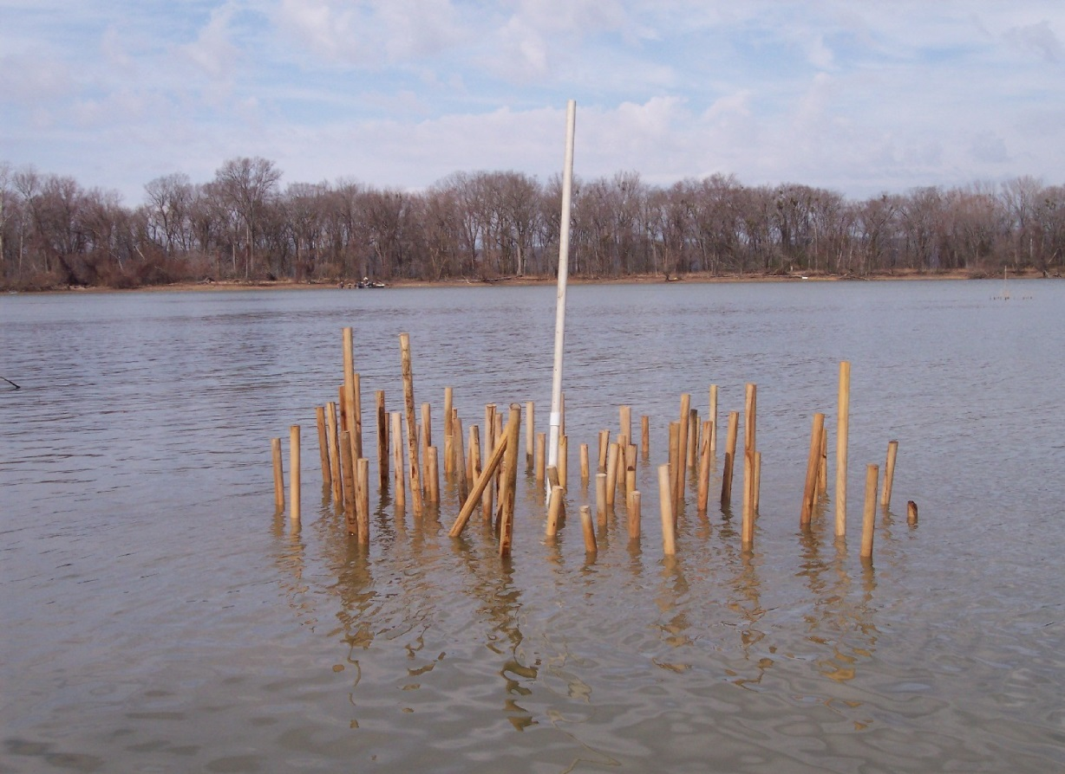

Slide 5
CHANGES IN HABITAT
In 2018-19 the Tennessee Fish and Wildlife Commission (TFWC) approved a budget expansion to the Fish Habitat Program to place greater emphasis on habitat projects and to develop artificial structures for increased longevity.

Slide 6
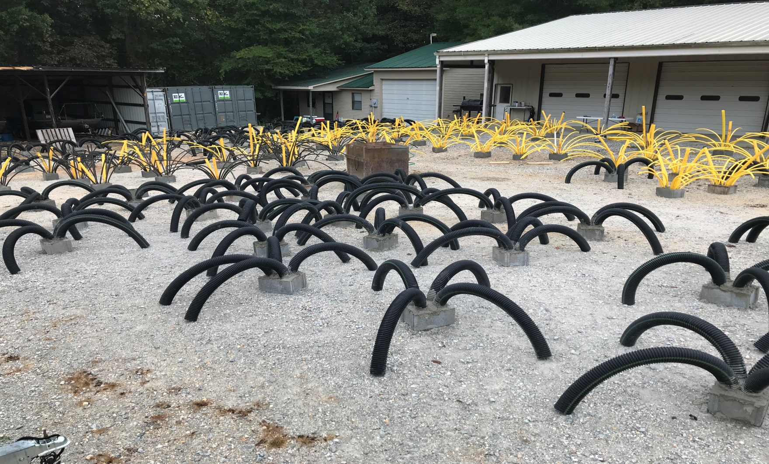
EXAMPLES OF ARTIFICIAL FISH ATTRACTORS AFTER CONSTRUCTION

Slide 7
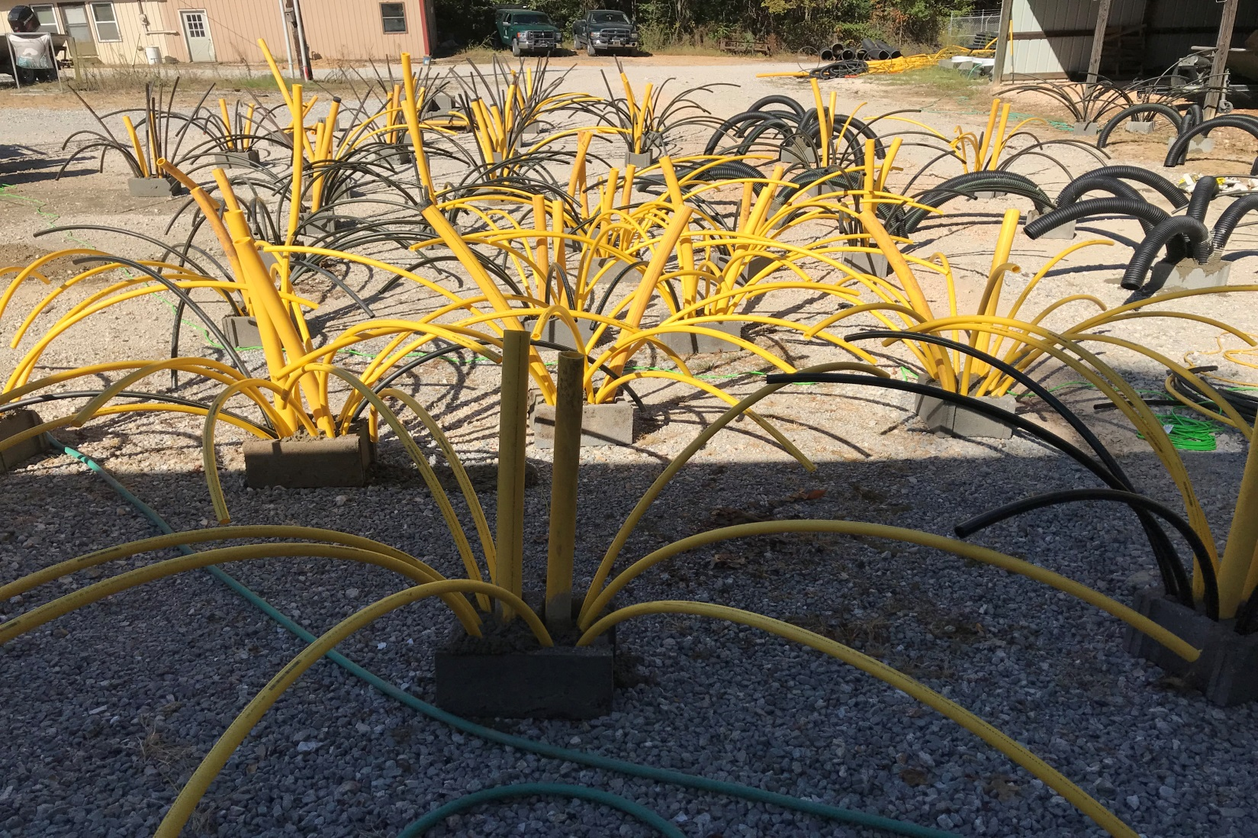
EXAMPLES OF ARTIFICIAL FISH ATTRACTORS AFTER CONSTRUCTION

Slide 8
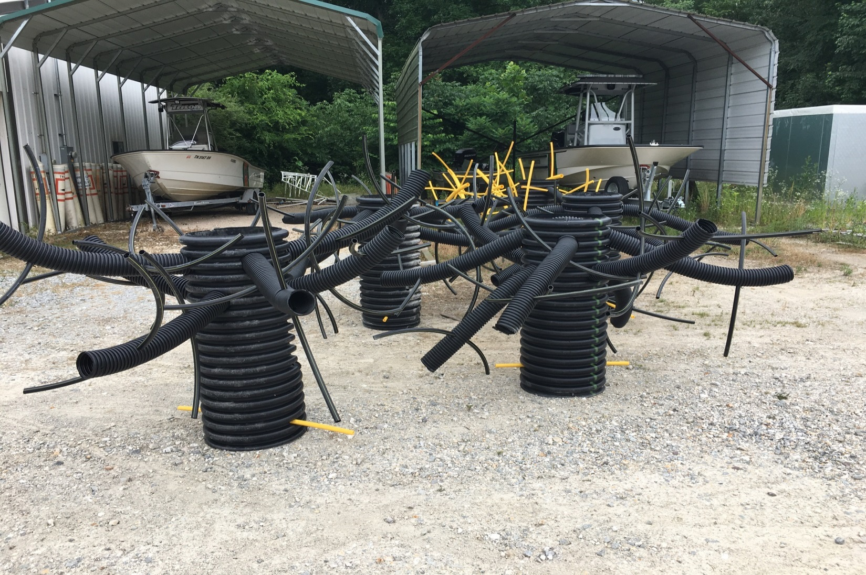
DEEP WATER ARTIFICIAL FISH ATTRACTORS “WOOLY BOOGER”

Slide 9
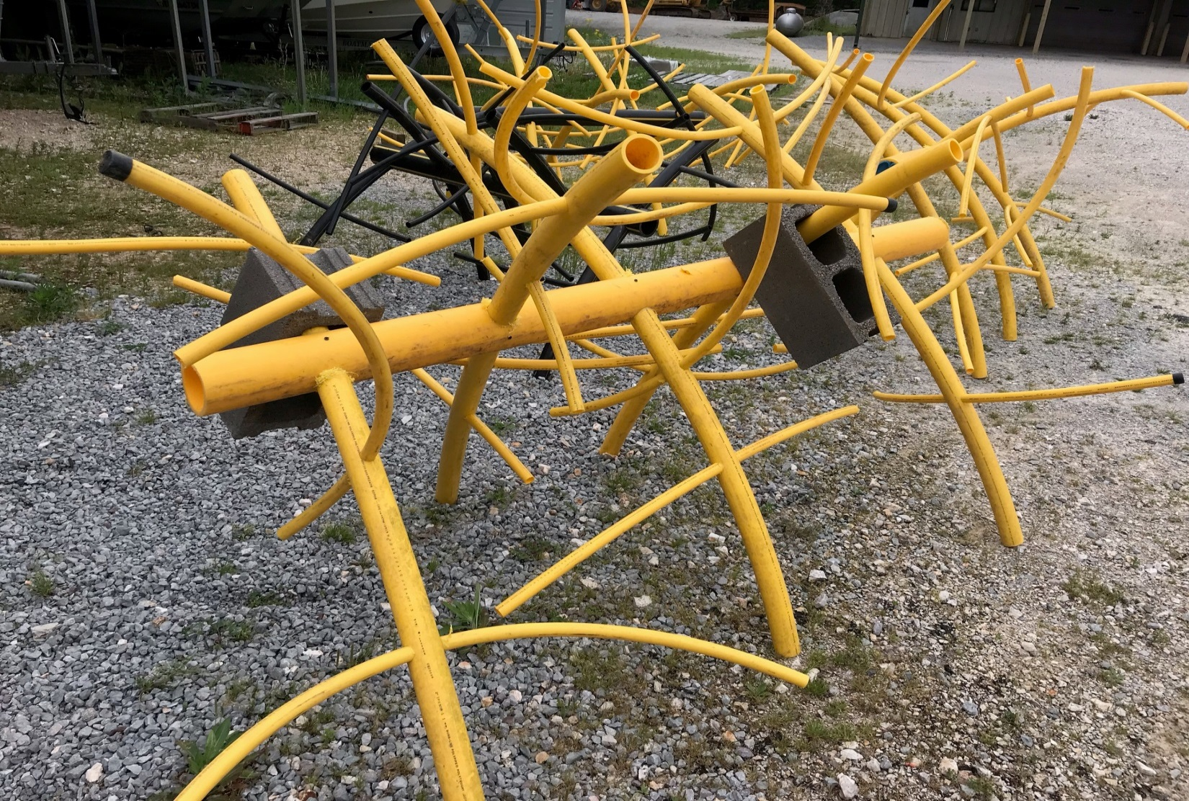
ARTIFICIAL FISH ATTRACTORS BUILT OUT OF LEFT OVER MATERIALS

Slide 10
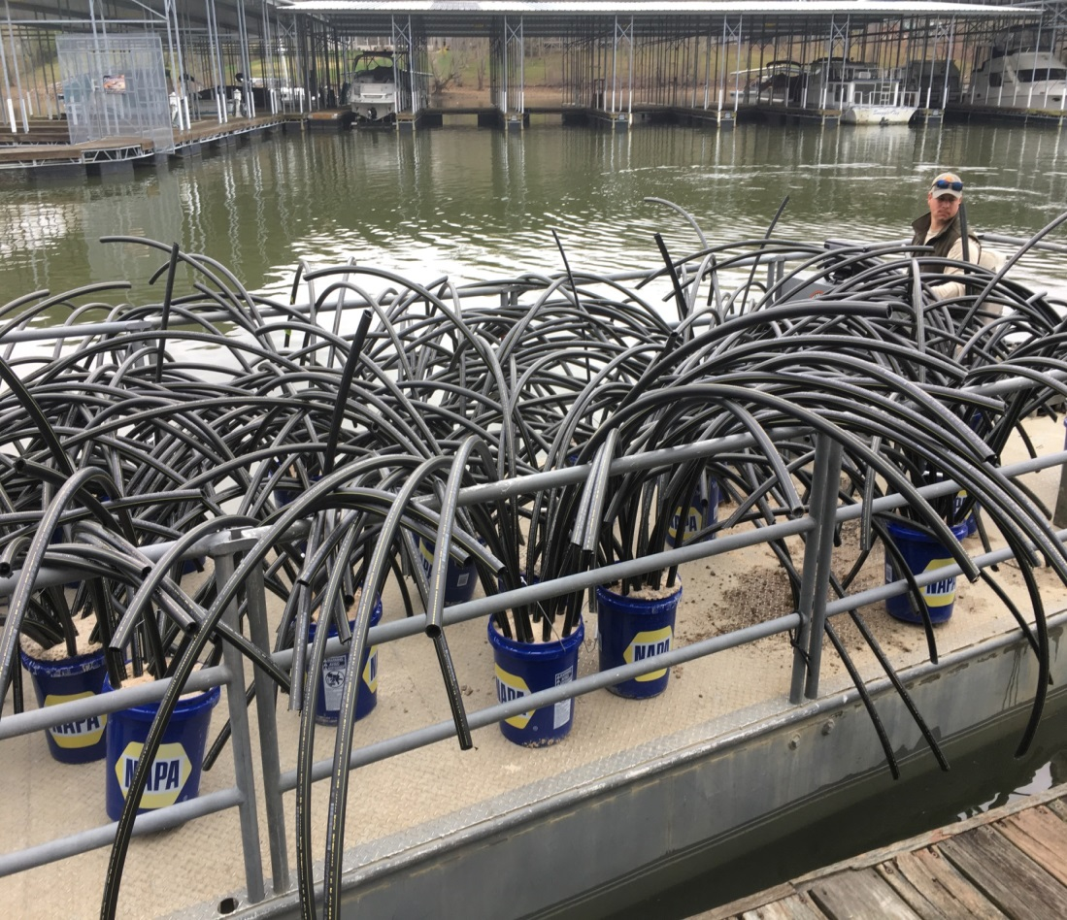
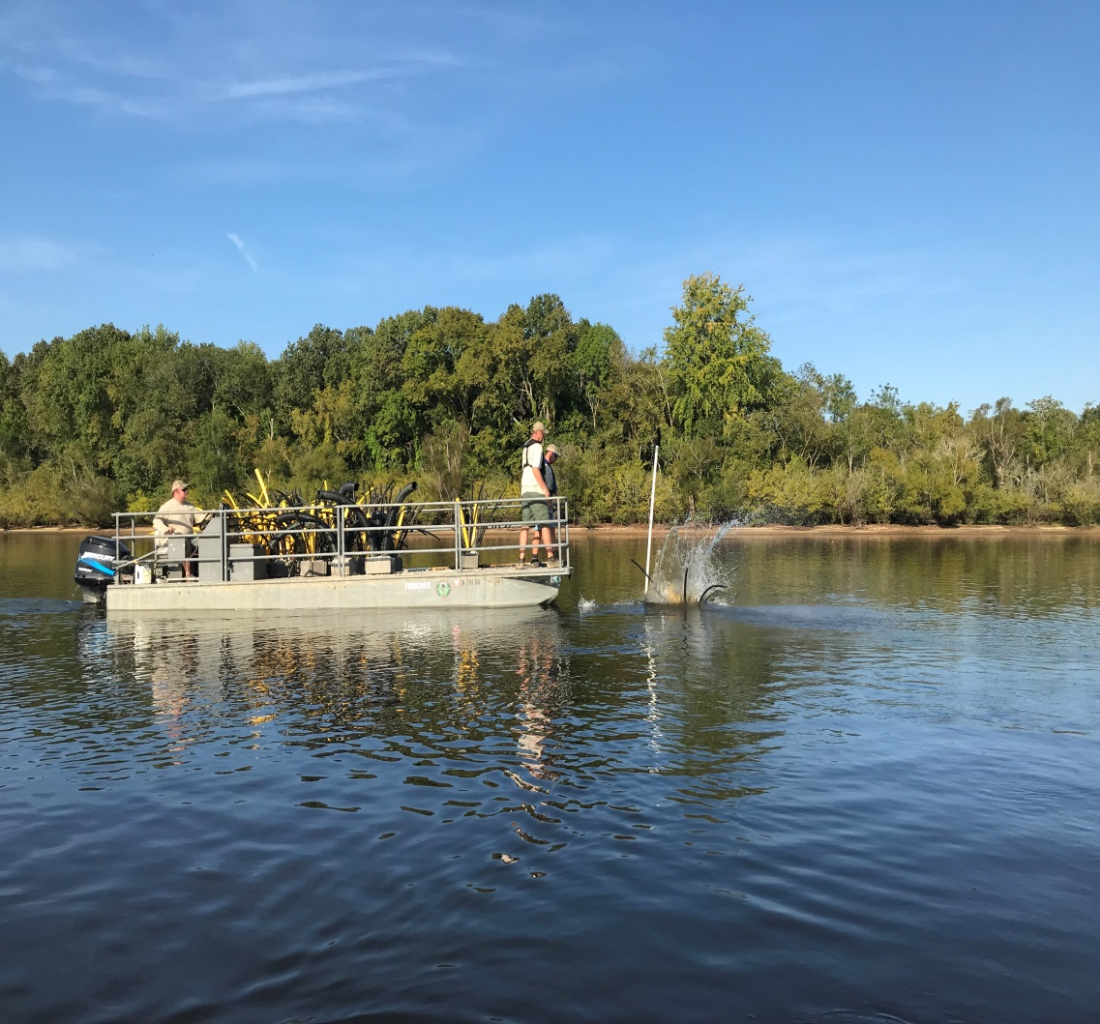
HOW THE ATTRACTORS ARE INSTALLED

Slide 11
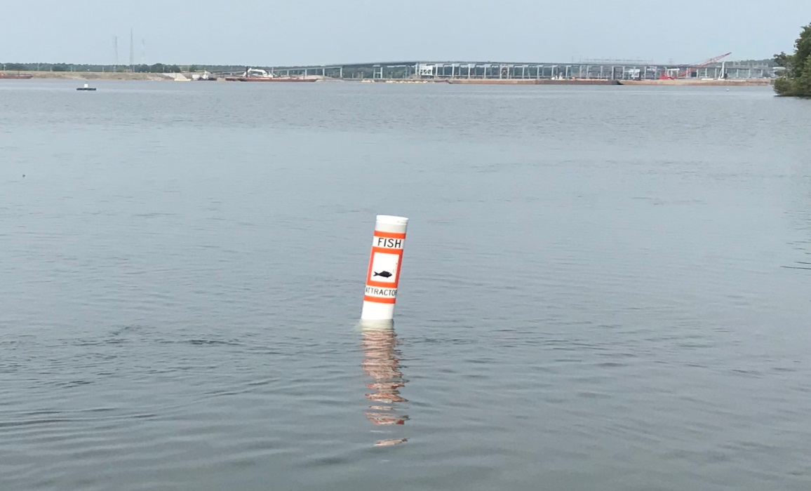
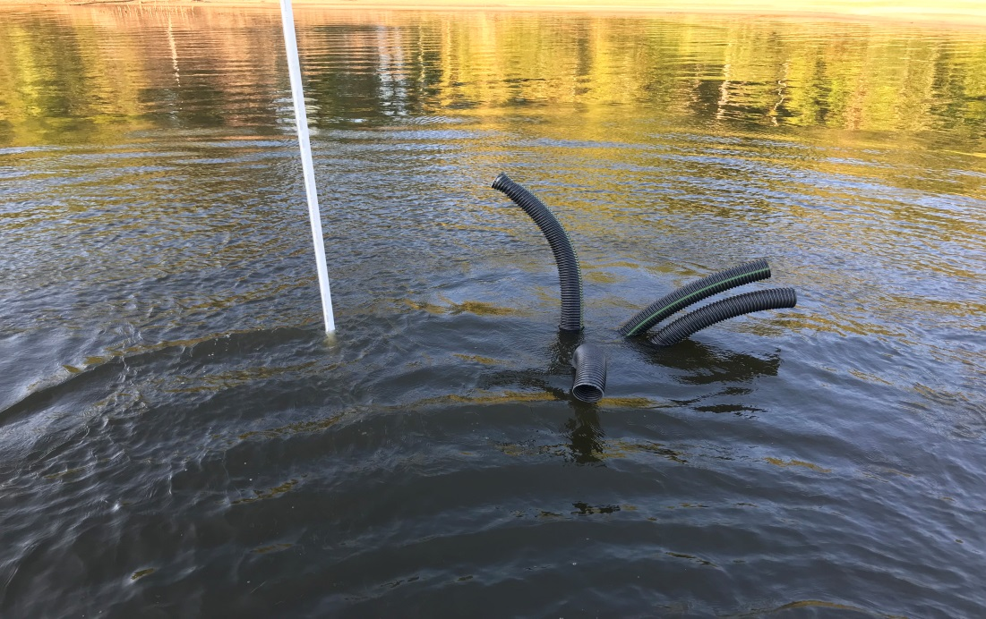
HOW THEY ARE MARKED

Slide 12
PLANS FOR EXISTING FISH ATTRACTOR SITES
The Regional Fish Habitat crew will continue to maintain historic shallow and deep water sites on Kentucky Reservoir.
Artificial structures will be used to maintain existing sites.
Once all sites have artificial structures, expansions will be developed.

Slide 13
EXPANSION TO OTHER RESERVOIRS
Barkley and Pickwick Reservoirs have received deep water artificial attractors in TWRA sampled embayments for evaluation.
Additional attractors will be installed on these reservoirs in the future.

Slide 14
NEW FISH ATTRACTOR SITES
Barkley Reservoir
Saline Creek
Neville Bay
Gatlin Point
Hickman Creek
Dyer Creek
Lick Creek
Guice Creek
Yellow Creek
Pickwick Reservoir
Pickwick Landing State Park Marina
Blowing Spring
Haw Branch
Pompey Branch
Dry Creek
North Winn Springs

Slide 15
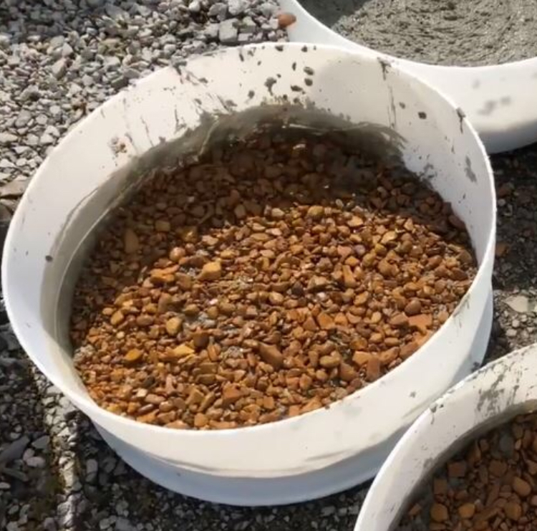
OTHER PROJECTS INCLUDE ARTIFICIAL SPAWNING STRUCTURES TO
ASSIST WITH FISH REPRODUCTIVE SUCCESS; AND A COOPERATIVE HABITAT IMPROVEMENT PROJECT BETWEEN TWRA (REGION 1), US ARMY CORP OF ENGINEERS, AND WESTERN KENTUCKY DEPARTMENT OF FISH AND WILDLIFE RESOURCES THAT WILL FOCUS ON SHALLOW WATER HABITAT ON BARKLEY RESERVOIR.

Slide 16
RESOURCES FOR ADDITIONAL INFORMATION
Check the TWRA website in the fishing section for maps of the fish attractor sites.
https://www.tn.gov/content/tn/twra/fishing/reservoirs/reservoir-fish-attractor-maps.html
Use the TWRA On the Go app with the use of a smartphone.

