Slide 1
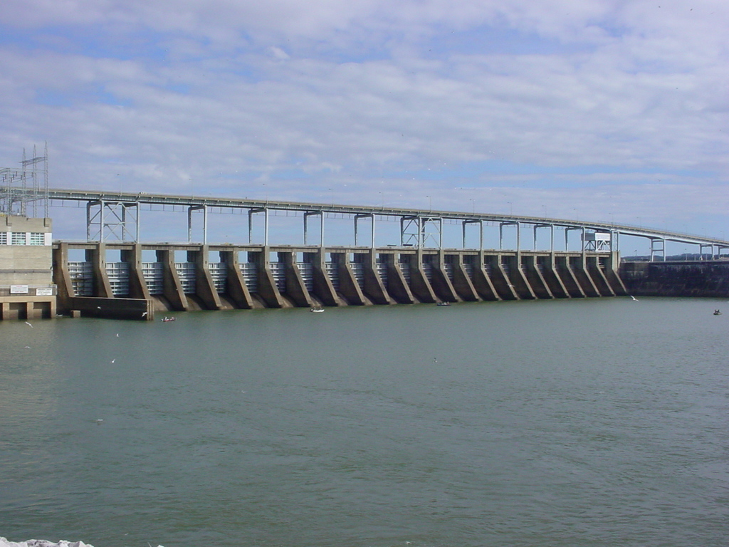
Fisheries Management Florida Largemouth Bass Stocking Kentucky Reservoir
Michael Clark
Reservoir Biologist

Slide 2
Florida Largemouth Bass Stocking Project (Kentucky Reservoir)
The stocking program was designed to increase the percent composition of Florida Largemouth Bass in the population.

Slide 3
Prestocking Genetic Analyses
In 2015 and 2016, fin clips were collected from Largemouth Bass reservoir wide to gather baseline genetic information.
Paris Landing area – 19% Florida Largemouth Bass composition
Harmon Creek – 29% Florida Largemouth Bass composition
Tom’s Creek – 14% Florida Largemouth Bass composition
Beech River – 12% Florida Largemouth Bass composition
Pickwick Dam area – 15% Florida Largemouth Bass composition

Slide 4
Florida Largemouth Bass stockings, Kentucky Reservoir
Initial (Pilot) Stocking
1998 through 2004
Limited to Harmon Creek
500 acres.
282,930 fingerlings stocked.
40,419 fingerlings stocked
per year.
Stocked 81fingerlings/acre/
year.
Florida Largemouth Bass stocking program was expanded in 2015.
In addition to Harmon Creek, Blue Creek in Humphrey’s County and Eagle Creek in Benton County were also stocked (1,162 acres).
902,527 fingerlings stocked.
180,506 fingerlings stocked per year.
Stocking rate: 2015 - 2019
Harmon Creek – 89/acre/year
Eagle Creek – 168/acre/year
Blue Creek – 305/acre/year
Ft. Loudon, Nickajack and Watts Bar reservoirs also received Florida LMB stockings in 2015 through 2019.

Slide 5
Florida Largemouth Bass stocking program objective
TWRA is stocking FLMB to create a shift in the genetic makeup of the current population of bass, increasing the presence of FLMB genes.
We expect these additional FLMB to displace the naturally produced LMB without any net gain in the number of young bass in the population. As such, the stocking program will not increase abundance of largemouth bass.

Slide 6
Additional Florida Largemouth Bass Stockings
Charlie Ingram stocking strategy
Stock 300,000 pure Florida Largemouth Bass in several embayments from the Big Sandy River embayment to Morgan Creek.
Fish stocked will be advanced fingerlings (2-inch to 2.5-inch fish) and will be stocked in May 2020.
Fish stocked will be pure Florida Largemouth Bass.
This stocking was approved by the Tennessee Wildlife Resources Agency.
This stocking does not provide permission for the public to stock fish in public waters.
These private individual stockings of Florida Largemouth Bass by Charlie Ingram and his partners should NOT be perceived as a method to increase bass numbers (abundance) in Kentucky Reservoir.

